Slide 1
CSE 602 - Wireless Network and Mobile Computing
Comparison of AODV, FSR and ZRP Routing Protocols
P22CS004 - Kalp Gohil
P22CS013 - Nihar Sodhaparmar

Slide 2
Content
Ad hoc On Demand Distance Vector (AODV)
Fisheye State Routing (FSR)
Zone Routing Protocol (ZRP)
Result and Analysis
Conclusion
References

Slide 3
Ad hoc On Demand Distance Vector (AODV)
AODV is a reactive routing protocol designed for ad hoc mobile networks.
DSR stores all the nodes in the path to the packet. As a result, if network size grows route path increase and data packet size also increase.
AODV is pure on-demand route acquisition system. The route are created when needed.
AODV basically involves two processes, one is route discovery and other is route maintenance.
It discovers routes by route request (RREQ) and route reply (RREP) messages and route maintenance is done by HELLO messages and route error (RERR) messages.

Slide 4
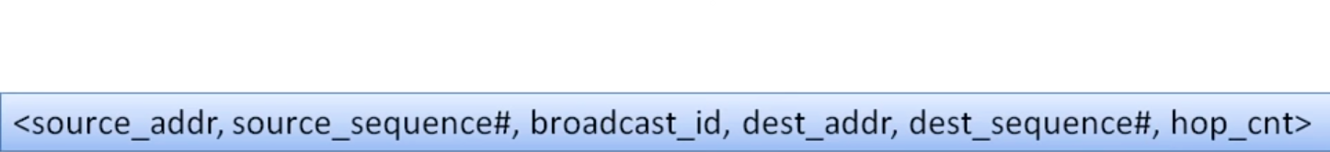
Ad hoc On Demand Distance Vector (AODV) …
Route Discovery:
When a source node wants to know the route to a destination, source node initiates route discovery and broadcasts a route request (RREQ) message to its neighbours. Each neighbour updates the information regarding source node after receiving this RREQ message. When a node re-broadcasts a route request, it sets up a reverse path pointing towards the source node in the route tables.
RREQ data packet :
RREQ

Slide 5
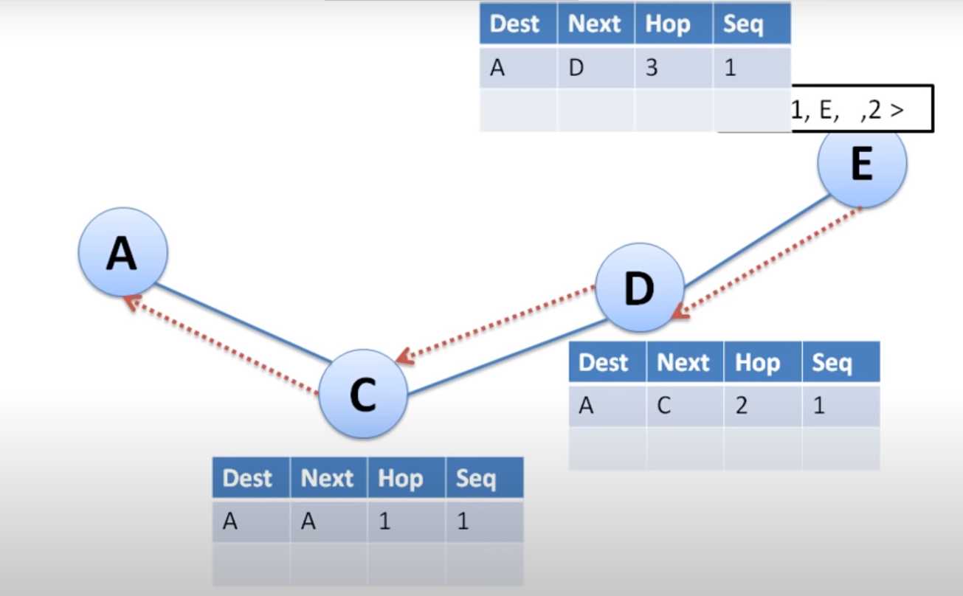
Ad hoc On Demand Distance Vector (AODV) …
Route Discovery:

Slide 6
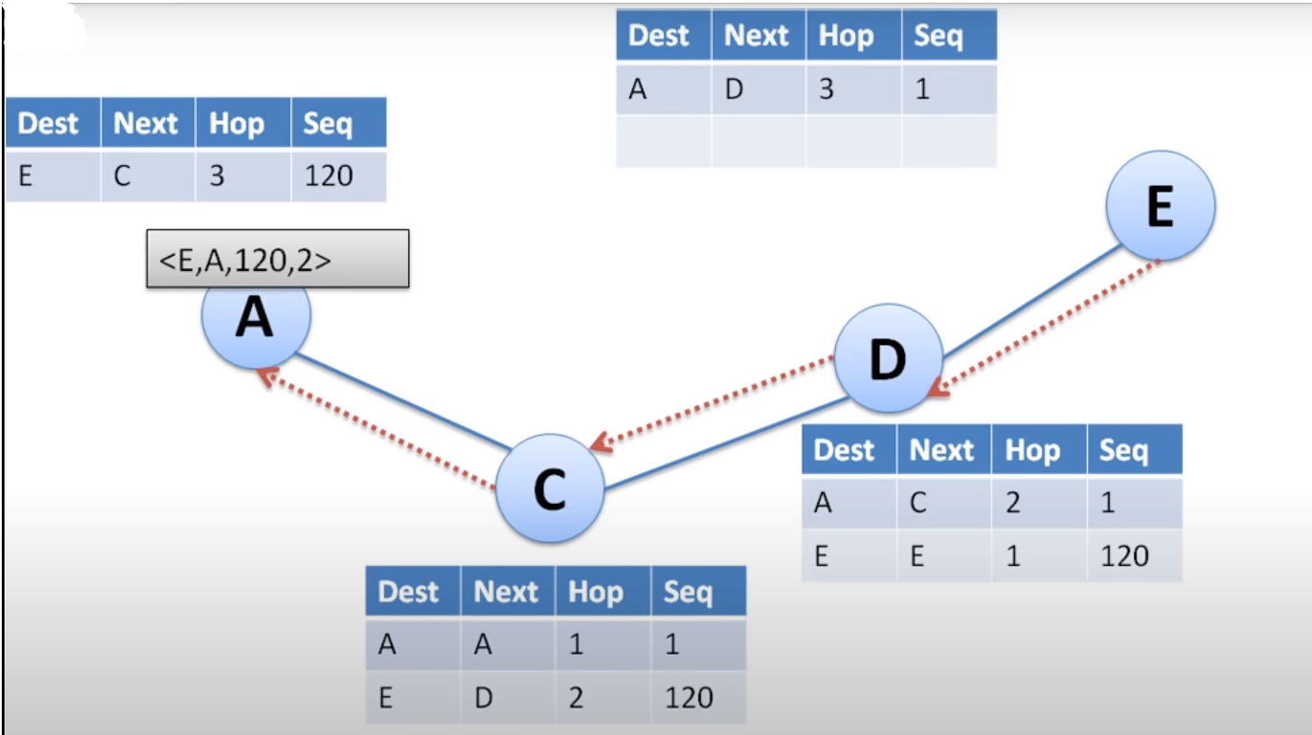
Ad hoc On Demand Distance Vector (AODV) …
Route Discovery:

Slide 7
Ad hoc On Demand Distance Vector (AODV) …
Route Maintenance:
A route is active if there are data packets periodically travelling from the source node to the destination node along that path.
To know about active neighbors each neighboring nodes periodically exchange HELLO messages.
When a link break occurs while the route is active, all active neighbors are informed and link failures are propagated by means of route error (RERR) messages to the source node, which also update destination sequence numbers.
After receiving the RERR message, the source node invalidates the route and can re-initiate route discovery, if desired.

Slide 8
Fisheye State Routing (FSR)
It is an implicit hierarchical routing protocol.
It reduces the routing update overhead in large networks by using a fisheye technique.
It is originates from global state routing.
Fisheye has the ability to see objects the better when they are nearer to its focal point that means each node maintains accurate information about near nodes and not so accurate about far-away nodes.
Fisheye routing uses multiple scopes. Scope defined as number of node can be reached within a given number of hops.
Scope is defined as number of nodes reachable within a given number of hops.

Slide 9
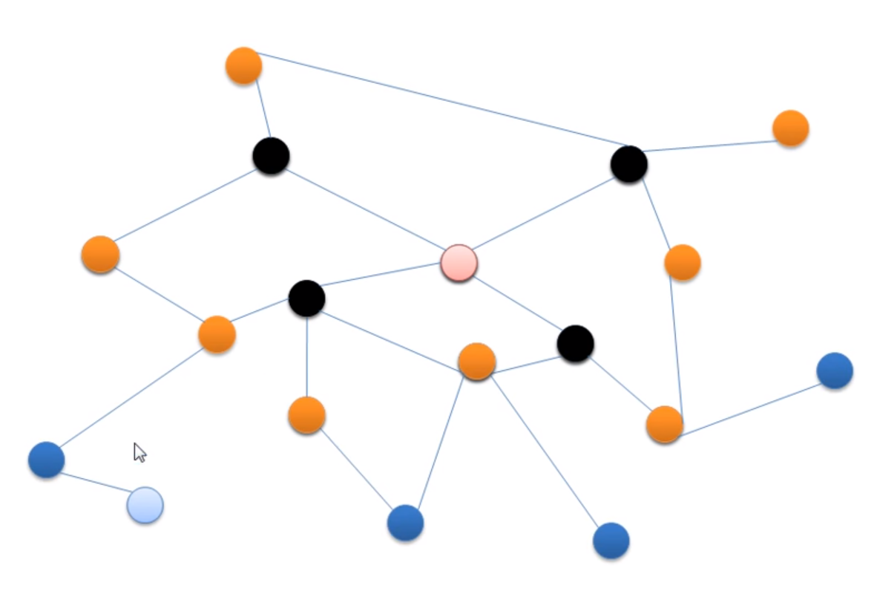

Slide 10
Fisheye State Routing (FSR) …
The number of levels and the radius of each scope will depend on the size of the network.
Entries corresponding to nodes within the smaller scope are propagated to the neighbors with the highest frequency and the exchanges in smaller scopes are more frequent than in larger.
FSR minimized the consumed bandwidth as the link state update packets that are exchanged only among neighboring nodes and it manages to reduce the message size of the topology information due to removal of topology information concerned far-away nodes.
Even if a node doesn’t have accurate information about far away nodes, the packets will be routed correctly because the route information becomes more and more accurate as the packet gets closer to the destination.

Slide 11
Zone Routing Protocol (ZRP)
It is hybrid hybrid protocol.
It takes advantage of proactive discovery within a node's local neighborhood, and using a reactive protocol for communication for farther away nodes.
The packet can be routed proactively if its destination is within local zone and reactive routing is used if the destination is outside the zone.

Slide 12
Zone Routing Protocol (ZRP) …
Zone Routing Protocol involves many components such as IARP and IERP.
IntrA-zone Routing Protocol (IARP) is the locally proactive routing component of ZRP and IntEr-zone Routing Protocol (IERP) is the globally reactive routing component of ZRP.
If a node sends a packet to another node then it should be checked whether the destination is outside the zone or within its local zone using information provided by IARP.
In IARP, to know about the topology of its routing zone, each node continuously maintains the routing information of all nodes within its routing zone.

Slide 13
Zone Routing Protocol (ZRP) …
In IERP the routing process is divided into two phases: the route request phase and the route reply phase.
In the route request phase, a route request packet is send by the source node to its peripheral nodes. If the receiver of a route request packet knows the destination, it responds by sending a route reply back to the source else it forwards the request packet to its neighbors.
A node discards the route request if it receives the several copies of the same route request.
In route reply phase, any node can send route reply packet if it provides a route to the destination.

Slide 14
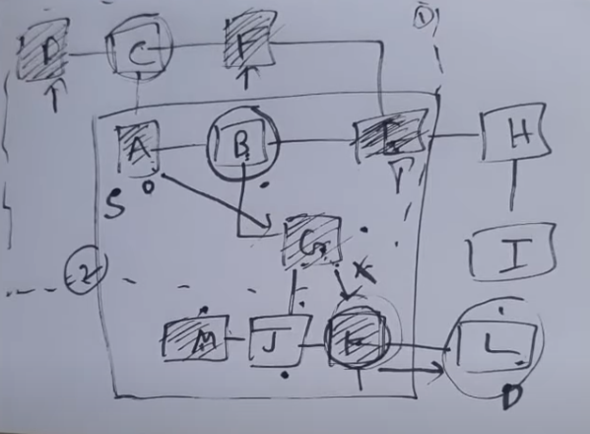
Zone Routing Protocol (ZRP) …

Slide 15
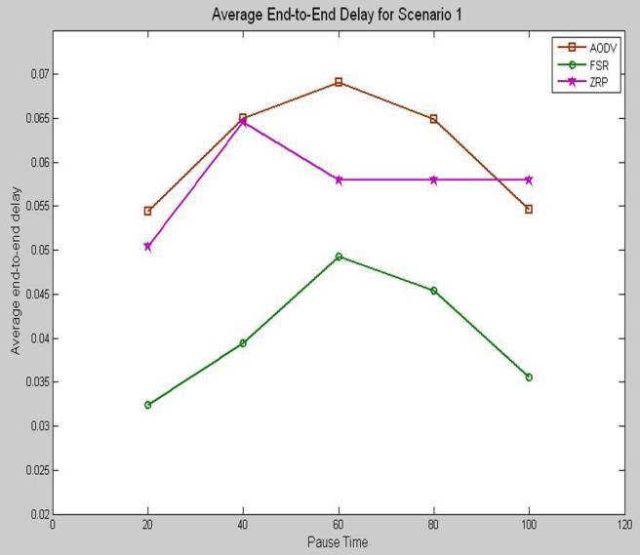
Result and Analysis
Average End-to-End Delay
End-to-end delay indicates how long it a packet takes to travel from the source to the application layer of the destination.

Slide 16
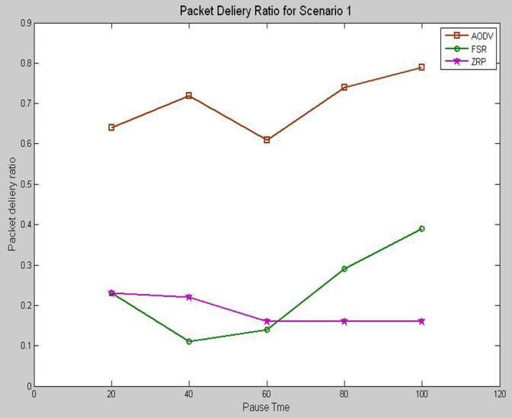
Result and Analysis
Packet Delivery Ratio
Packet delivery ratio is the fraction of packets sent by the application that are received by the receivers.

Slide 17
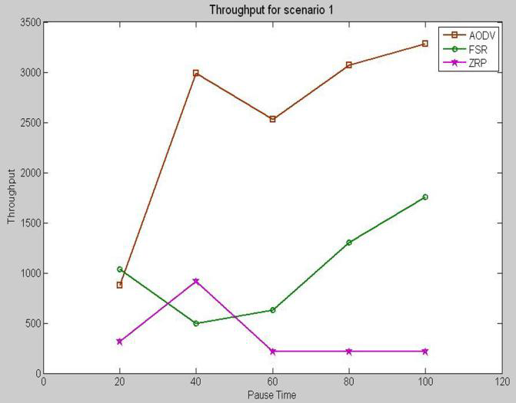
Result and Analysis
Throughput
The throughput is defined as the total amount of data a receiver receives from the sender divided by the time it takes for the receiver to get the last packet.

Slide 18
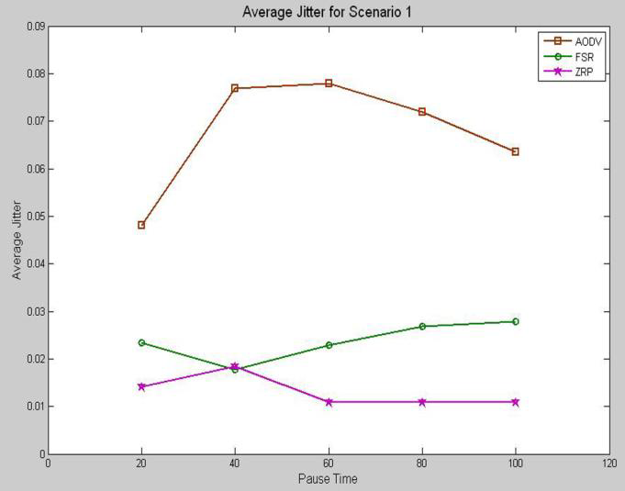
Result and Analysis
Jitter
Jitter is the variation in the time between packets arriving, caused by network congestion, timing drift, or route changes.
It should be less for a routing protocol to perform better.

Slide 19
Conclusion
AODV shows best performance than FSR and ZRP in terms of packet delivery ratio and throughput.
FSR show lowest end-to-end delay.
ZRP has less average jittering than AODV and FSR.
AODV performed the worst in case of average jitter.
ZRP performed the worst in case of throughput

Slide 20
References
Maurya, Ashish K., and Dinesh Singh. "Simulation based performance comparison of AODV, FSR and ZRP Routing protocols in MANET." International Journal of Computer Applications 12.2 (2010): 23-28.
Royer, Elizabeth M., and Charles E. Perkins. "Ad-hoc on-demand distance vector routing." Proceedings of the 2nd IEEE Workshop on Mobile Computing Systems and Applications. Vol. 2. No. 1999. 1999.
Ad hoc On Demand Distance Vector
Fisheye State Routing
Zone Routing Protocol

